Slide 1
Content Page
Visual Supports for Communication
Introduction
Orienting Questions
Feelings
Bowel/Urine
Sleep
Medication
Falls
Food & Drink
Daily Routine
Exercise
Family

Slide 2
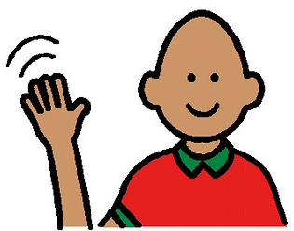
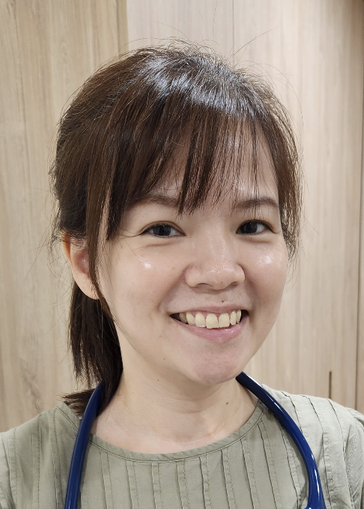
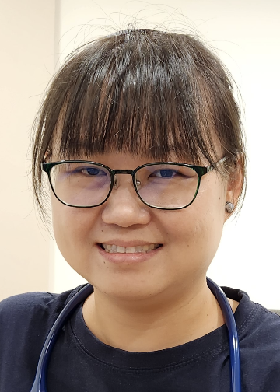
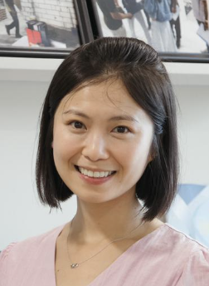
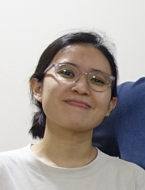
Introduction 1
Hello I am…
Angie
Pei Ing
Grace
Nad

Slide 3
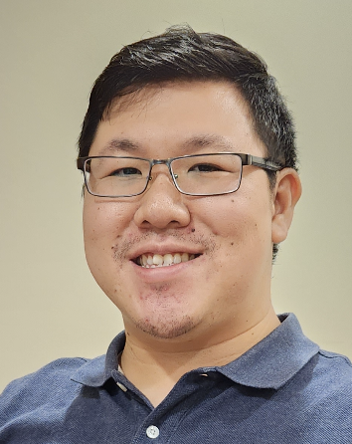
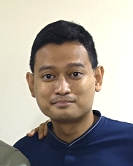
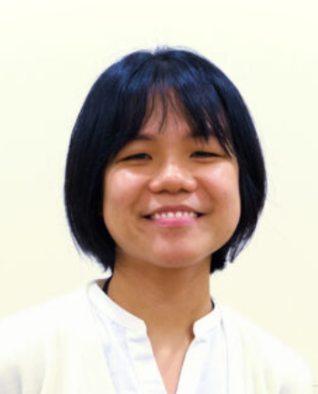
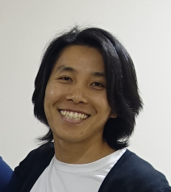
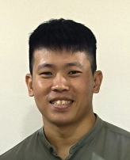
Introduction 2
Hello I am…
Justin
Ilham
Soo Wen
Norman
Caleb

Slide 4
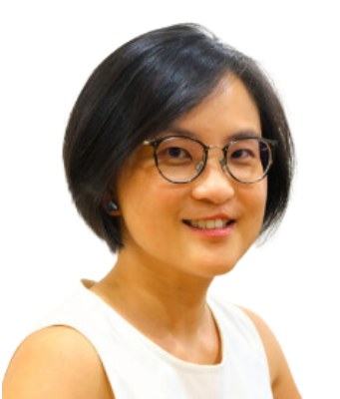
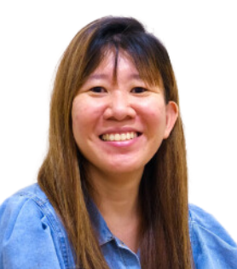
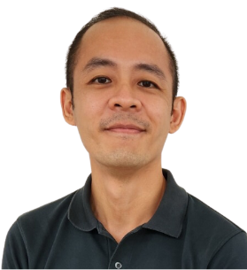
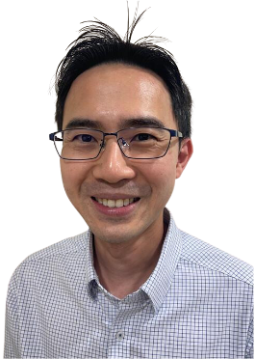
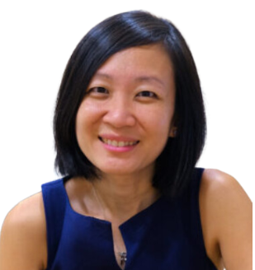
Introduction 3
Introduction 3
Hello I am…
Joy
Euan
Chris
Dr See
Dr Chen

Slide 5
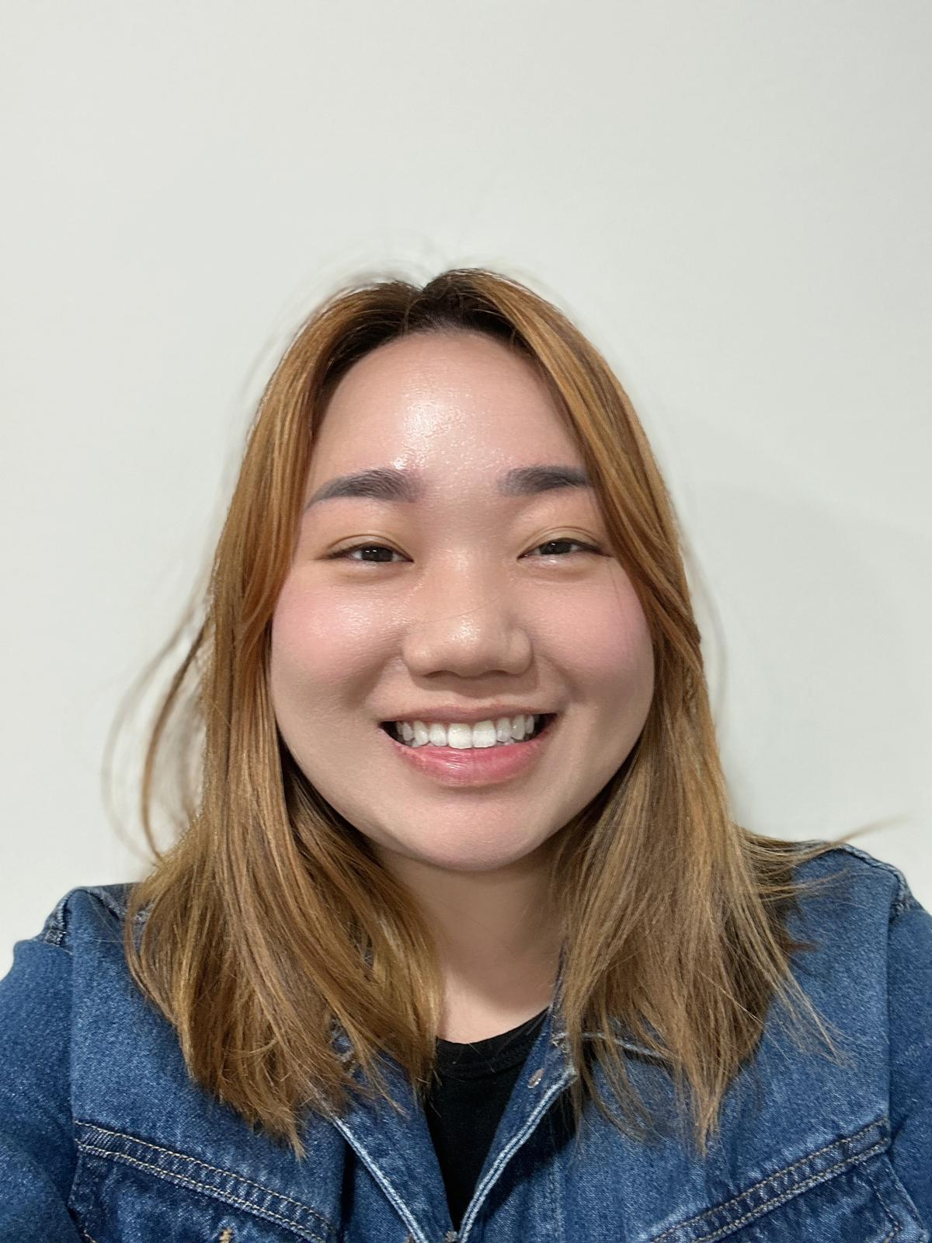
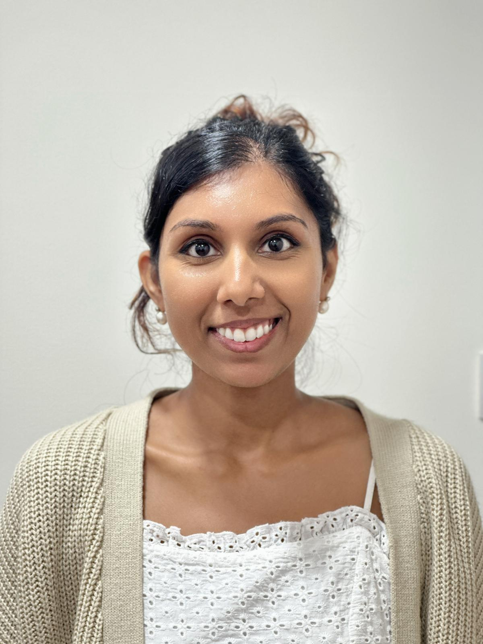
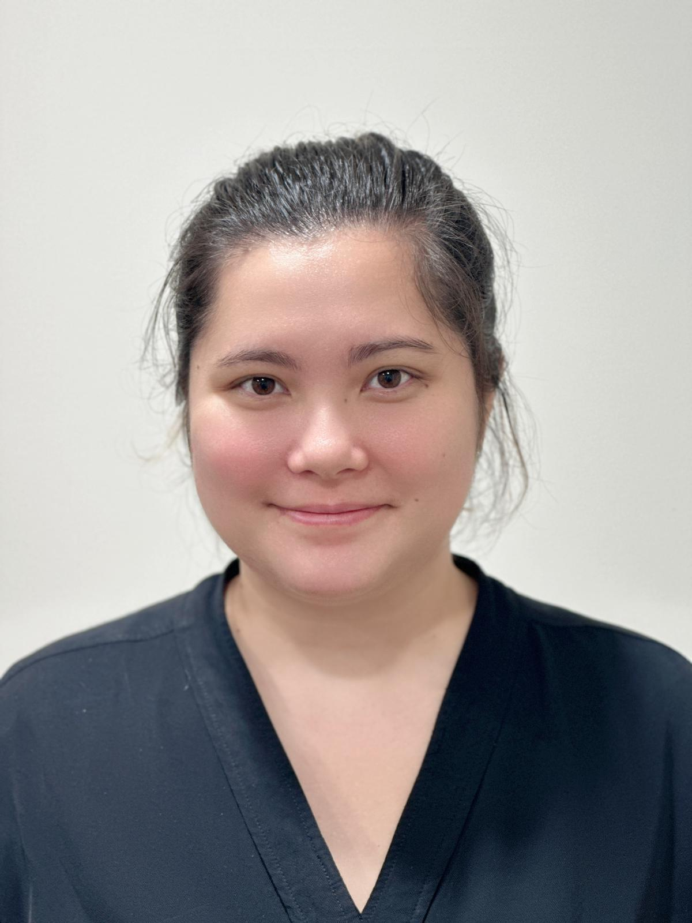
Introduction 4
Hello I am…
Deborah
Sadhana
Amanda

Slide 6
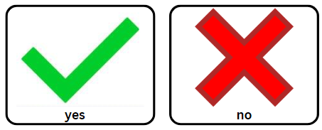
Orientation 1
Is your name?...

Slide 7
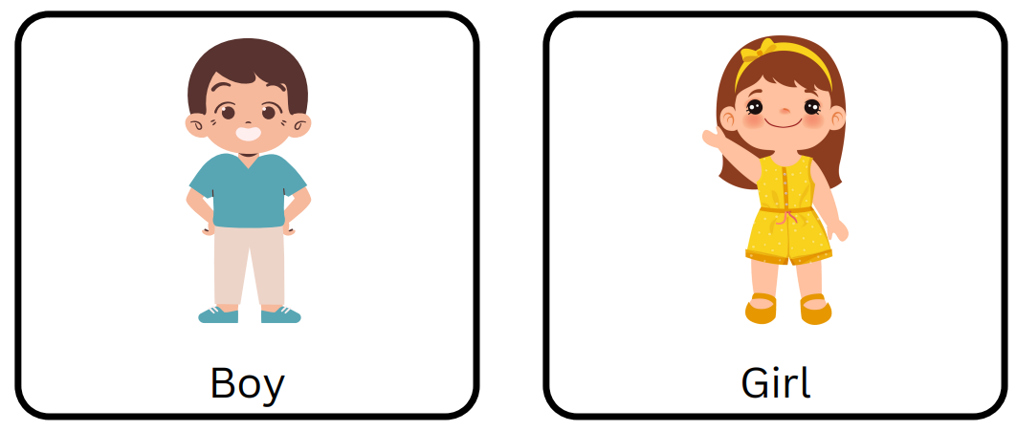
Orientation 2
Boy or Girl?

Slide 8
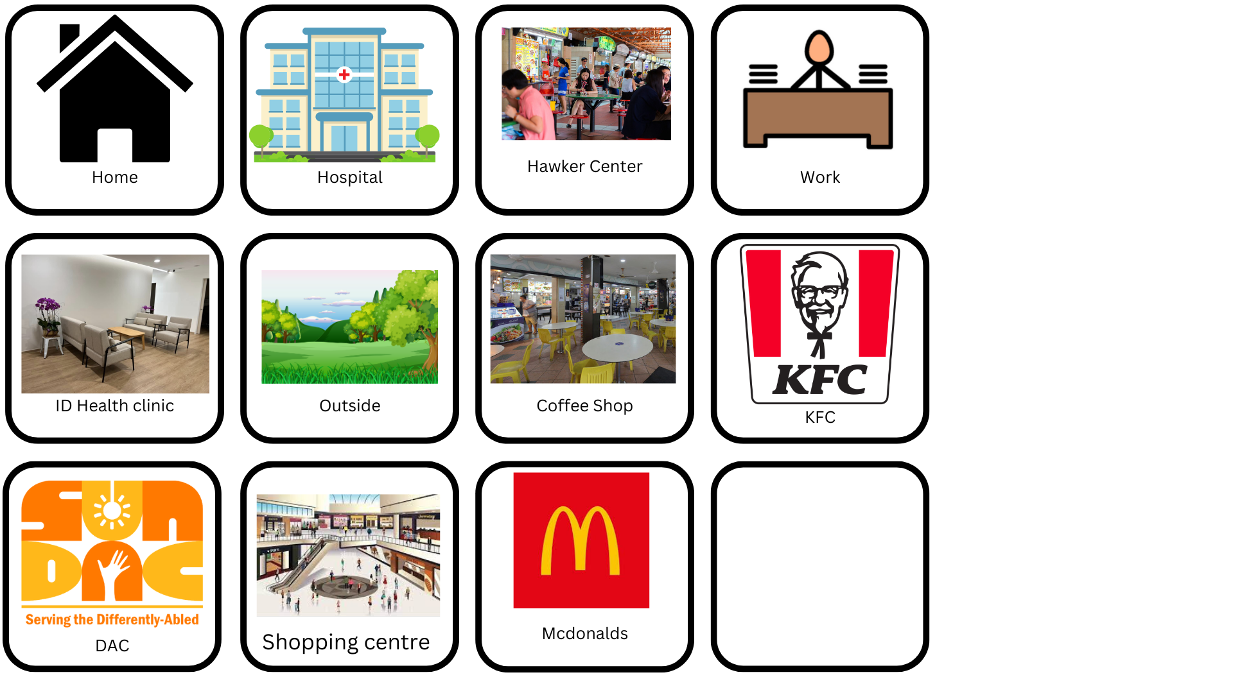
Orientation 3

Slide 9
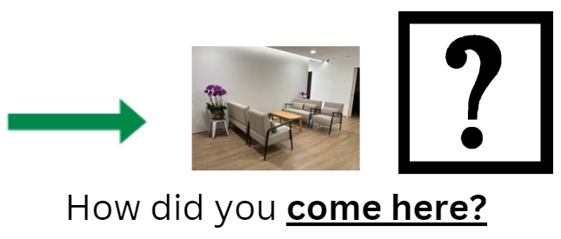
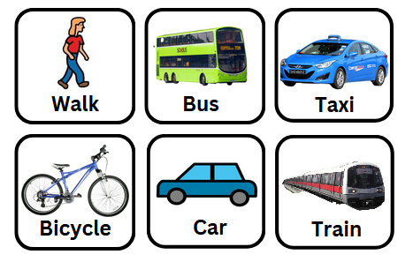
Orientation 4

Slide 10
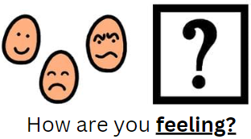
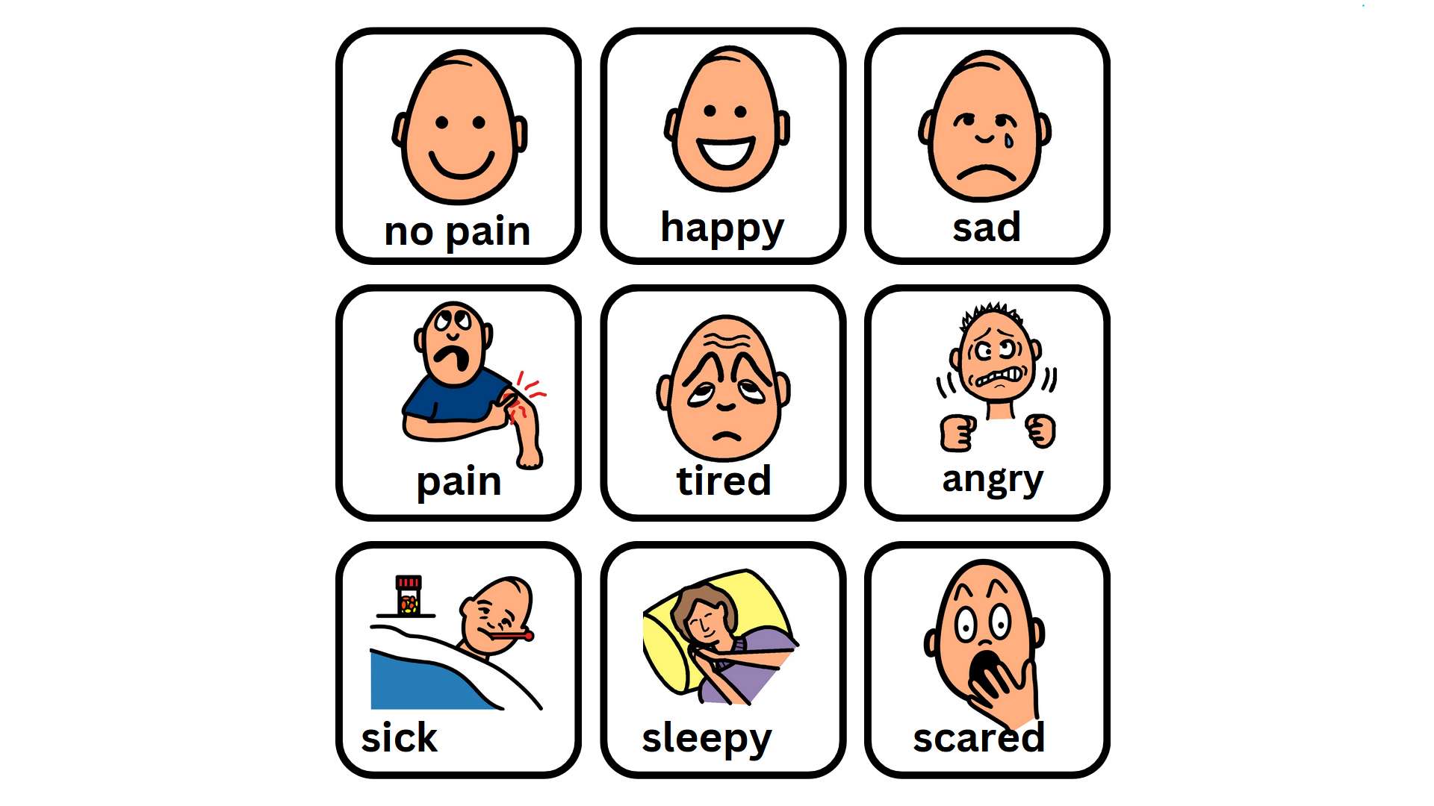
Feelings 1c
Notes:
Change frustrated to angry

Slide 11
Feelings / Pain2

Slide 12
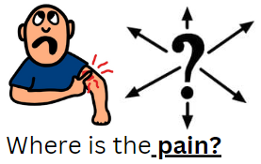
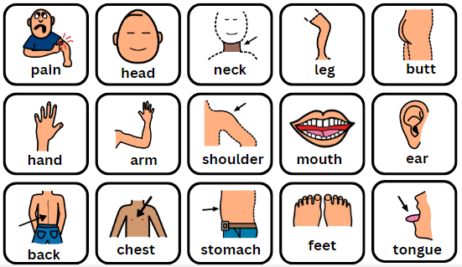
Feelings/Pain 3

Slide 13
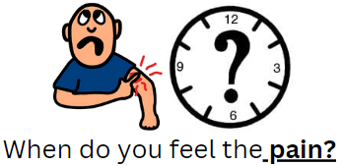
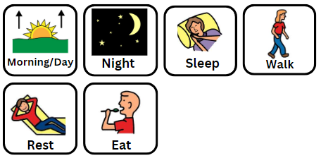
Feelings/Pain 4

Slide 14
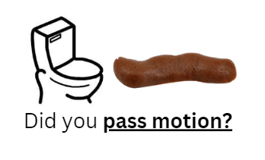
Bowel/Urine 1
Notes:
Pass motion

Slide 15
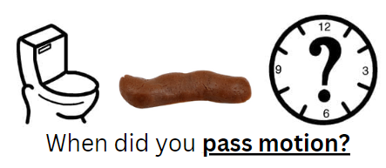
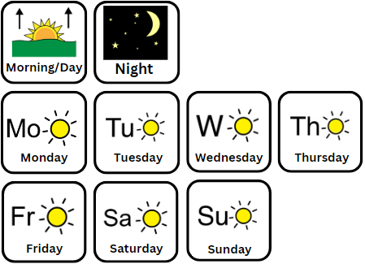
Bowel/Urine 2

Slide 16
Bowel/Urine 3

Slide 17
Bowel/Urine 4

Slide 18
Bowel/Urine 5
Notes:
Take out glass

Slide 19
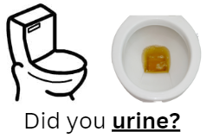
Bowel/Urine 6

Slide 20
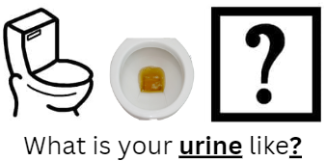
Bowel/Urine 6

Slide 21
Bowel/Urine 7

Slide 22
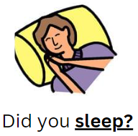
Sleep 1

Slide 23
Sleep 2

Slide 24
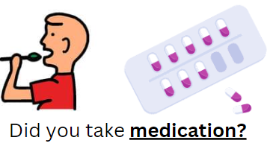
Medication 1

Slide 25
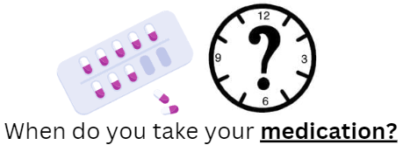
Medication 2

Slide 26
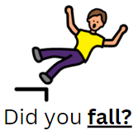
Fall 1

Slide 27
Fall 2

Slide 28
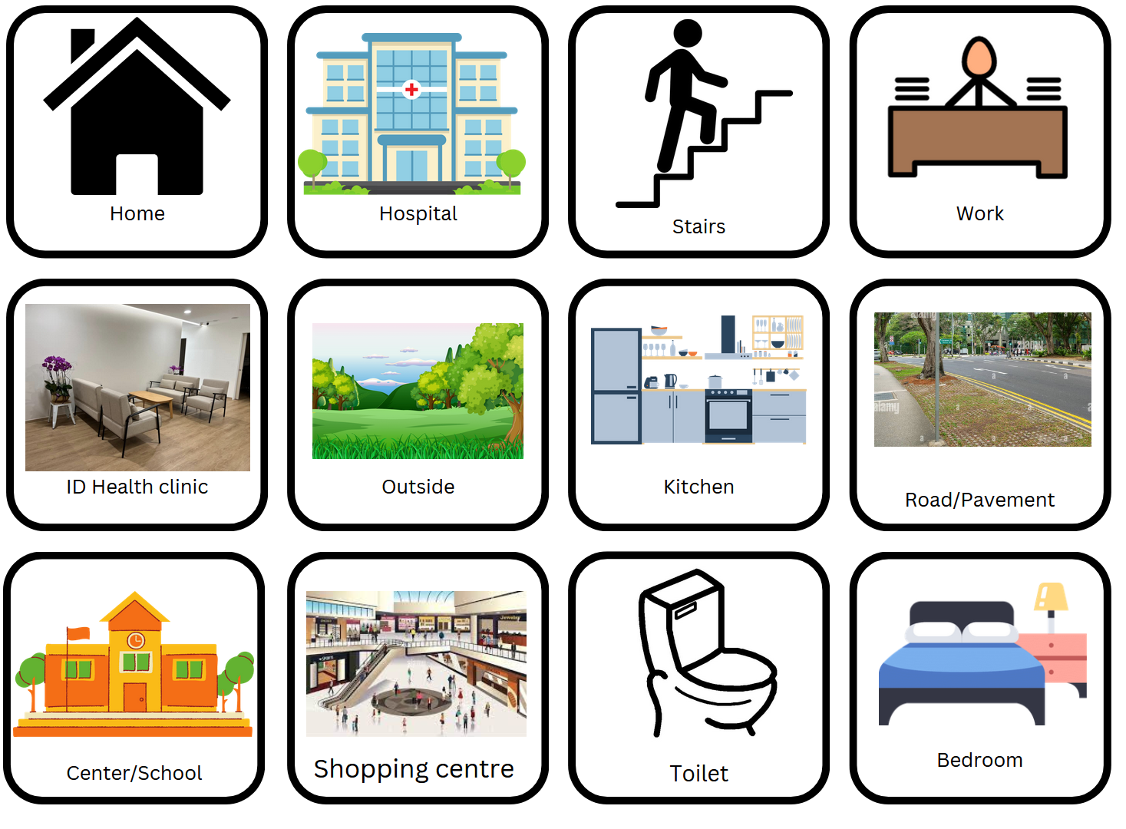
Fall 3
Notes:
Stairs
Toilet
Center/School
Road/Pavement
Bedroom
Kitchen
Take out mcdonalds and KFC

Slide 29
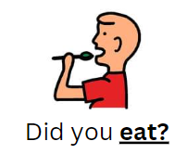
Food/Drink 1

Slide 30
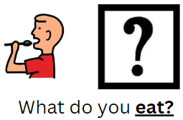
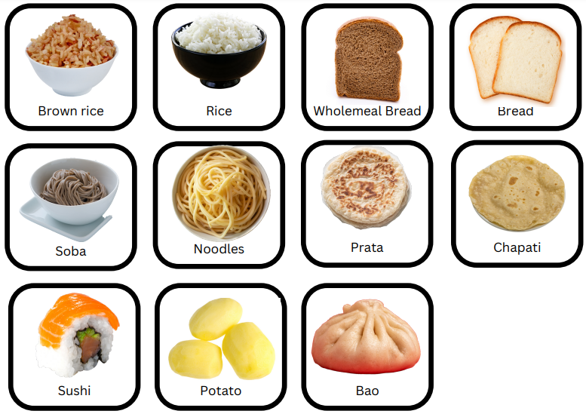
Food/Drink 2 (Carbs)

Slide 31
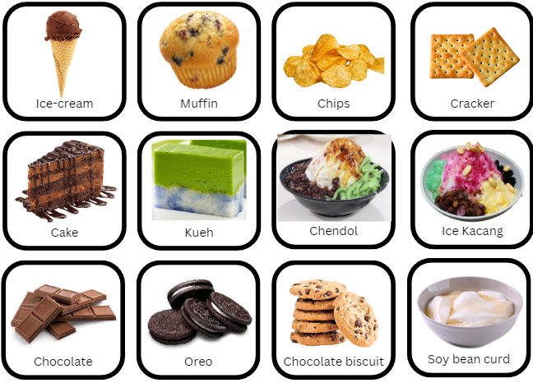
Food/Drink 3 (Desserts/Snacks)

Slide 32
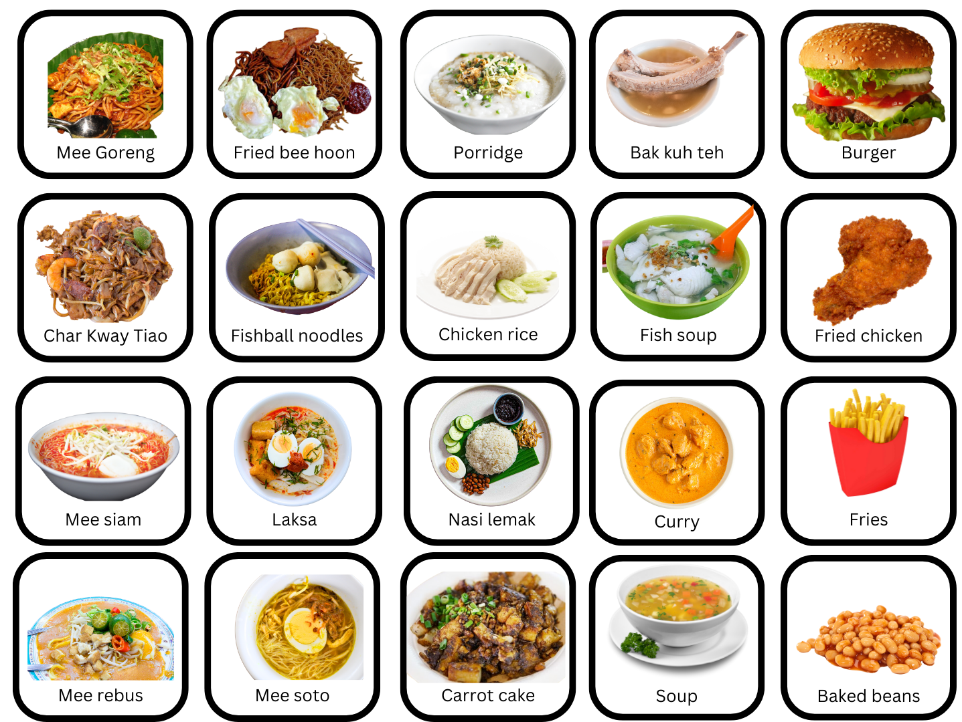
Food/Drink 4 (Mains)

Slide 33
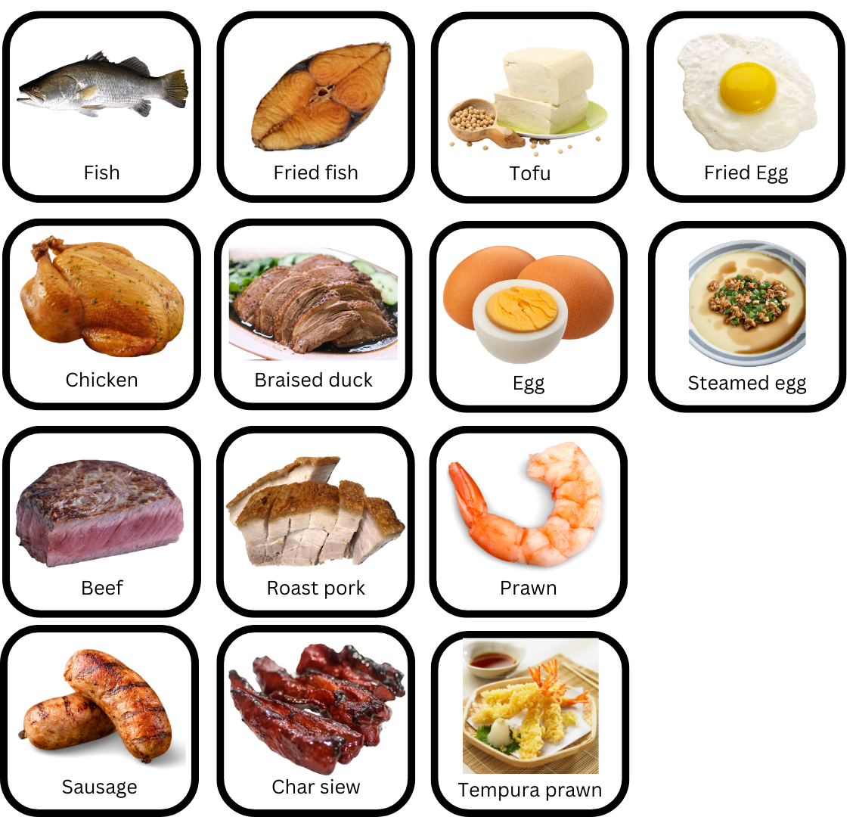
Food/Drink 5 Protein

Slide 34
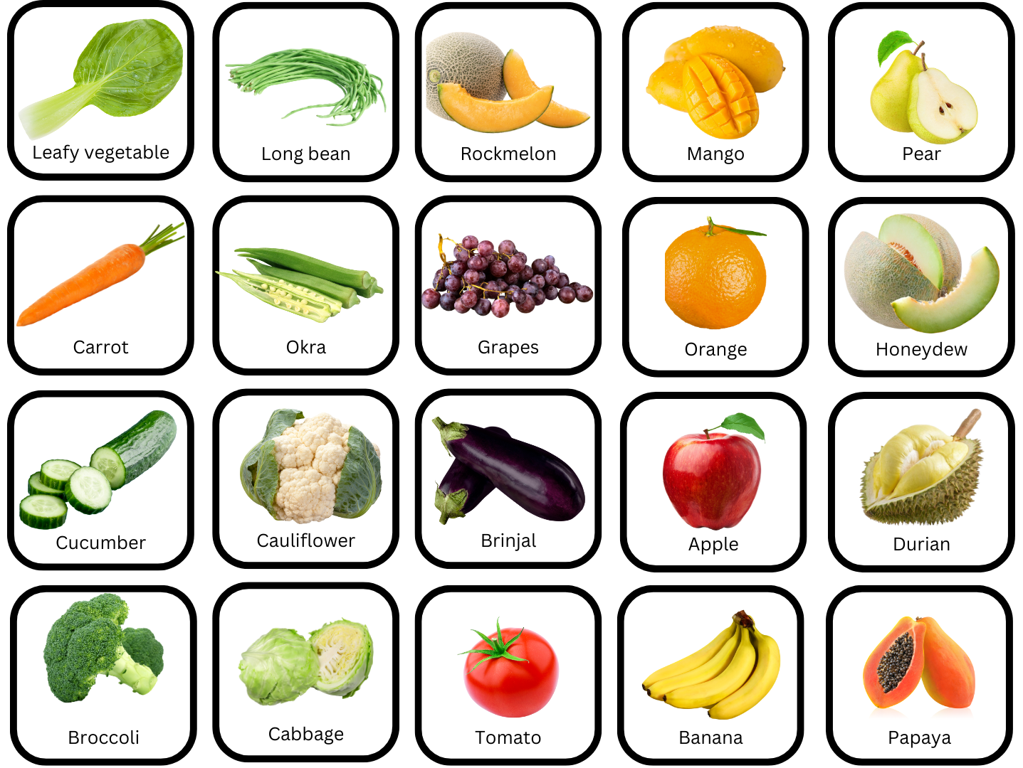
Food/Drink 6 (vegetables)

Slide 35
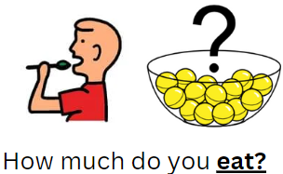
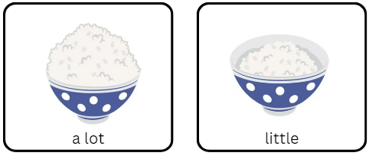
Food/Drink 7 (Quantity)
Notes:
Change to photograph of rice in a bowl

Slide 36
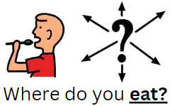
Food/Drink 8 (Places)

Slide 37
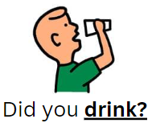
Food/Drink 9

Slide 38
Food/Drink 10 (Drink)

Slide 39
Food/Drink 11 (drinks)

Slide 40
Daily Routine 1
Notes:
eating out, centre, play games, listen music, church/mosque, talking to ppl, going out

Slide 41
Daily Routine 2
Notes:
eating out, centre, play games, listen music, church/mosque, talking to ppl, going out

Slide 42
Daily Routine 3
Notes:
eating out, centre, play games, listen music, church/mosque, talking to ppl, going out

Slide 43
Daily Routine 4
Notes:
eating out, centre, play games, listen music, church/mosque, talking to ppl, going out

Slide 44
Daily Routine 5

Slide 45
Exercise 1

Slide 46
Exercise 2

Slide 47
Exercise 3

Slide 48
Wants 1

Slide 49
Family
Who?

